Slide 1
MODULE III

Slide 2
Syllabus
Input/Output:
  Stream classes (byte stream and character stream classes)
  reading console input.
  Files

Slide 3
Input refers to flow of data into a program and output means flow of data out of a program.
Input to a program may come from various sources like keyboard, mouse, memory, disk, network.
Output of a program may go to several destinations like screen, printer, memory, disk, network.
Data that is transferred is treated as a sequence of bytes or characters.
Java uses concept of streams to represent ordered sequence of data.

Slide 4
IO Basics : Streams
Java programs perform I/O through streams.
A stream presents a uniform, easy-to-use, object-oriented interface between the program and the i/o devices. It is an abstraction that either produces or consumes information.
A stream is linked to a physical device by the Java I/O system.
All streams behave in the same manner, even if the actual physical devices to which they are linked differ. Thus, the same I/O classes and methods can be applied to any type of device.
Java implements streams within java.io package.

Slide 5
Java streams are classified into two basic types:
  Input stream
  Output stream
An input stream extracts(or reads) data from source(file) and sends it to the program. Similarly an output stream takes data from the program and sends it to the destination(file).
Java.io package contains a large number of stream classes that provide capabilities for processing all types of data.
Stream classes are categorized into two types based on the data on which they operate. They are:
  Byte Stream : Used for reading or writing binary data.
  CharacterStream : Used for handling input and output of characters.
  They use unicode.
At the lowest level, all I/O is byte-oriented.

Slide 6
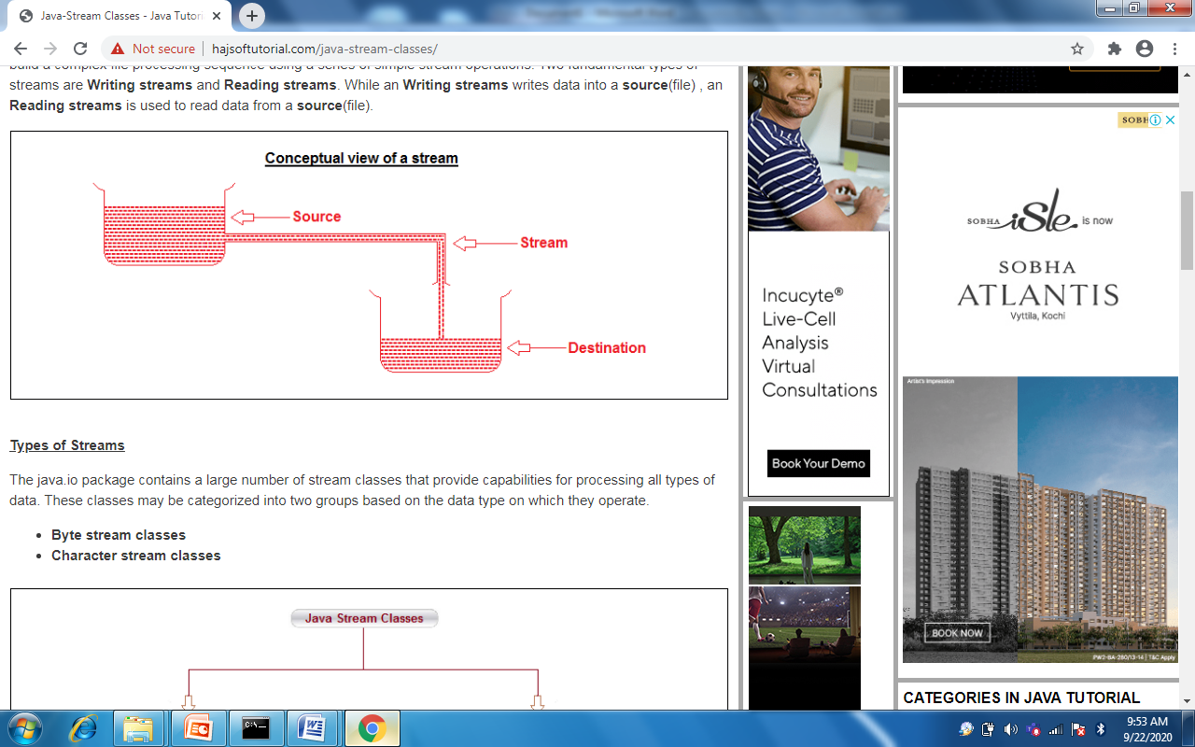

Slide 7
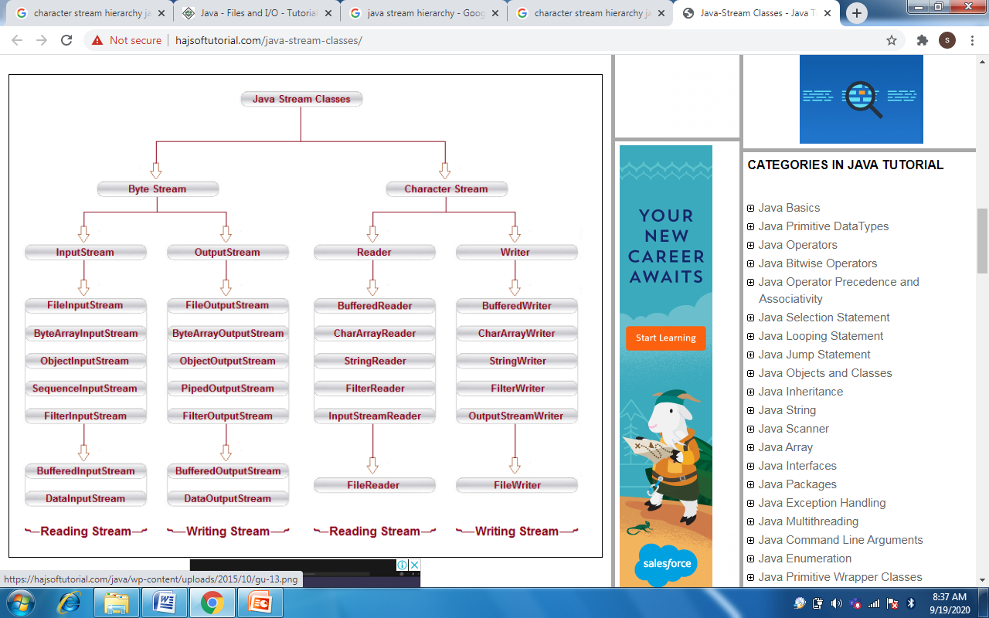
Java Stream Classes Hierarchy

Slide 8
Byte Streams Classes
Two abstract classes for Byte streams :
  InputStream
  OutputStream
These classes define several key methods that the other stream classes implement.
Eg: read( ) and write( ), which, respectively, read and write bytes of data. Both methods are declared as abstract. They are overridden by derived stream classes.
Each of these abstract classes has several concrete subclasses, that handle various devices, such as disk files, network connections, memory buffers etc.
Java.io package has to be imported to use stream classes.

Slide 9
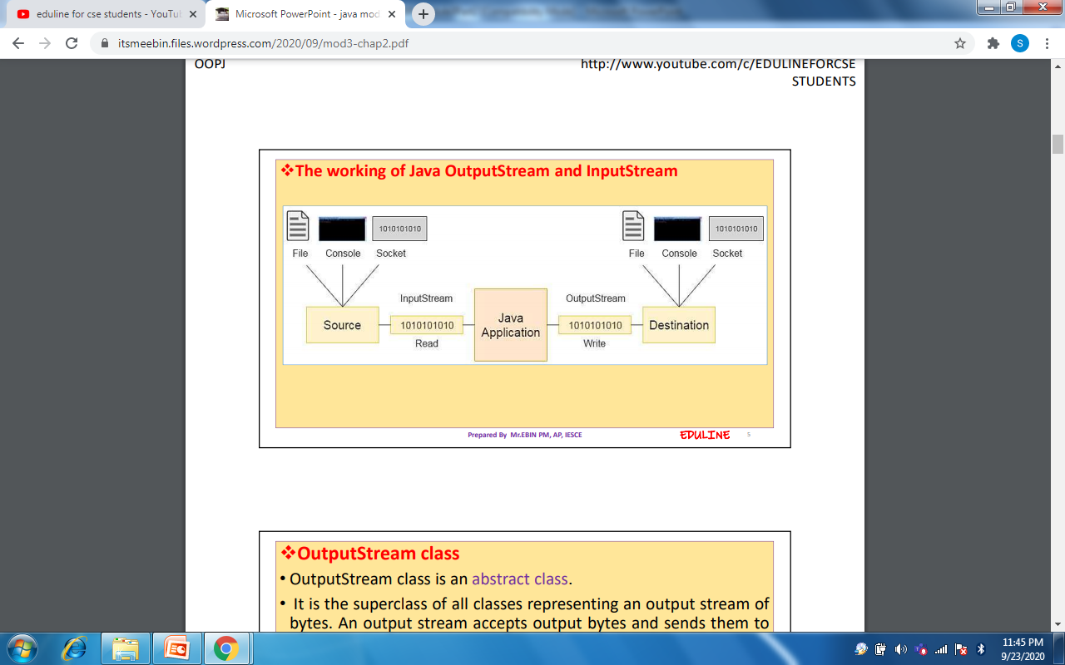

Slide 10
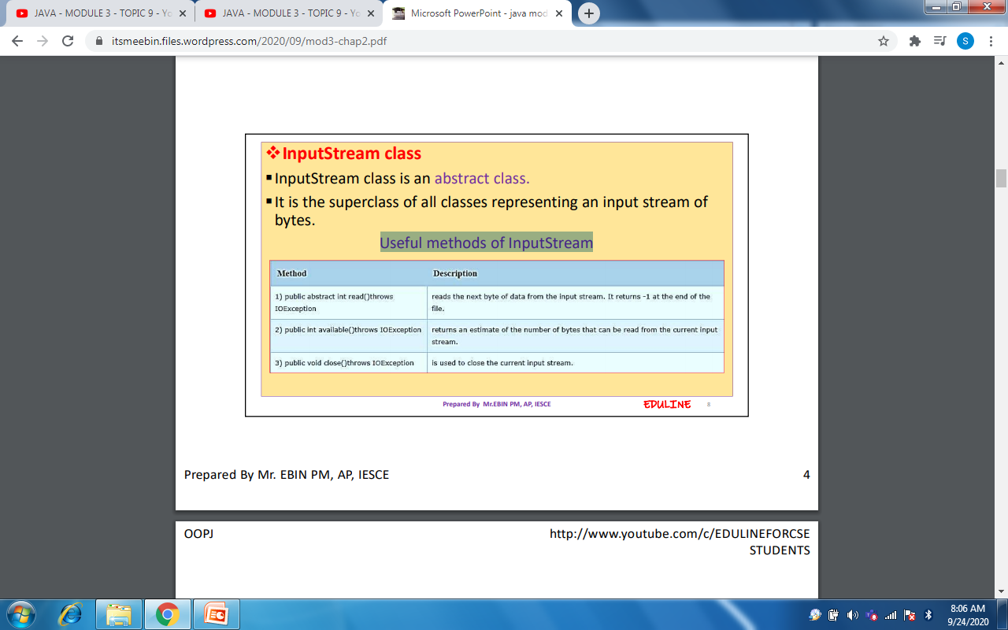
InputStream class
InputStream class is an abstract class.
It is the superclass of all classes representing an input stream of bytes.

Slide 11
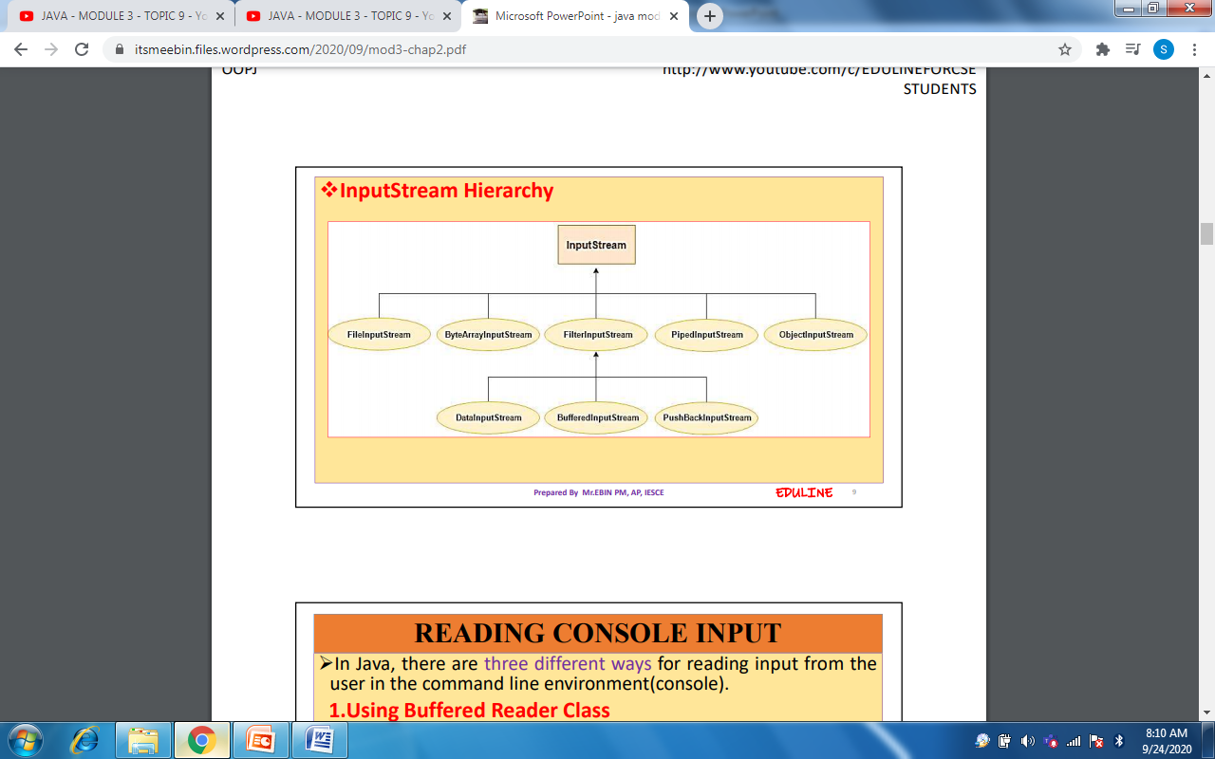

Slide 12
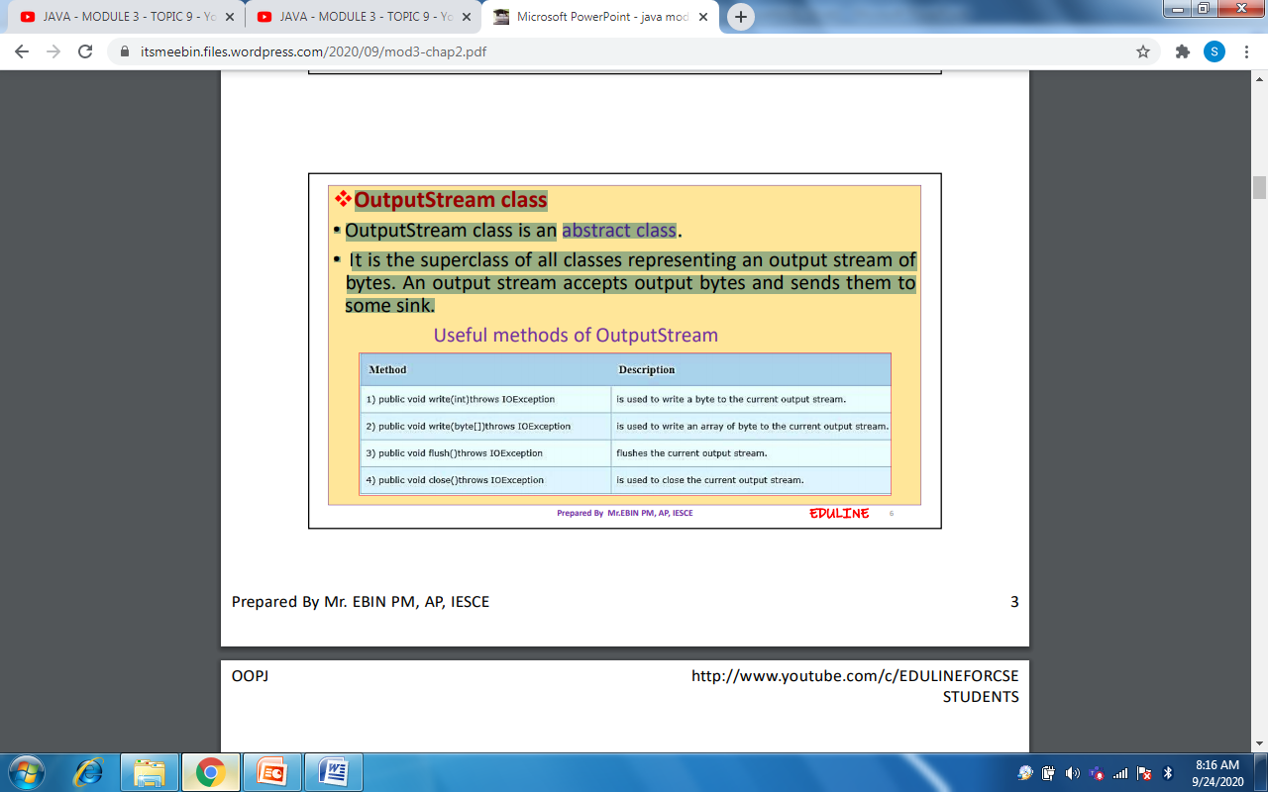
OutputStream class
It is the superclass of all classes representing an output stream of bytes.
It is an abstract class.
An output stream accepts output bytes and sends them to some sink.

Slide 13
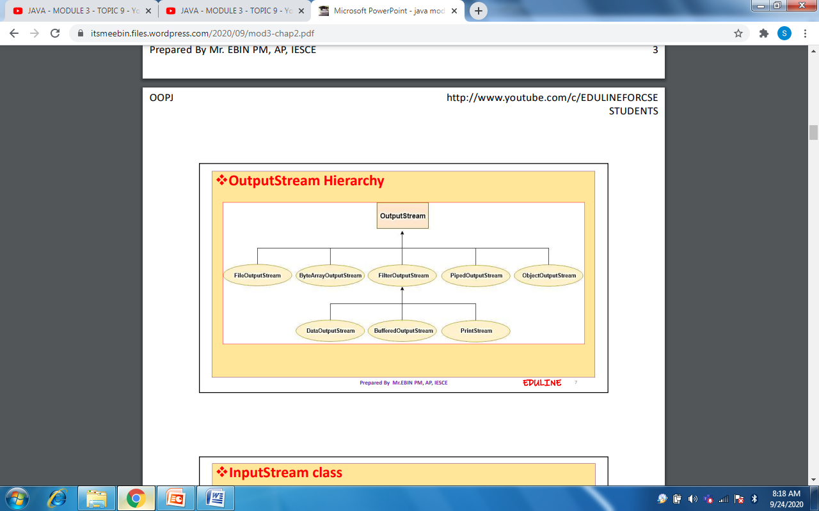

Slide 14
Byte Stream Classes
Stream Class | Meaning
BufferedInputStream | Buffered input stream
BufferedOutputStream | Buffered output stream
ByteArrayInputStream | Input stream that reads from a byte array
ByteArrayOutputStream | Output stream that writes to a byte array
DataInputStream | An input stream that contains methods for reading the Java standard data types
DataOutputStream | An output stream that contains methods for writing the Java standard data types
FileInputStream | Input stream that reads from a file
FileOutputStream | Output stream that writes to a file
FilterInputStream | Implements InputStream
FilterOutputStream | Implements OutputStream
InputStream | Abstract class that describes stream input
OutputStream | Abstract class that describes stream output
PipedInputStream | Input pipe
PipedOutputStream | Output pipe
PrintStream | Output stream that contains print( ) and println( )
PushbackInputStream | Input stream that supports one-byte “unget,” which returns a byte to the input stream
RandomAccessFile | Supports random access file I/O
SequenceInputStream | Input stream that is a combination of two or more input streams that will be read sequentially, one after the other

Slide 15
BufferedInputStream Class
The BufferedInputStream class of the java.io package is used with other input streams to read the data (in bytes) more efficiently.
It extends the InputStream abstract class.
Working of BufferedInputStream
The BufferedInputStream maintains an internal buffer of 8192 bytes.
During the read operation in BufferedInputStream, a chunk of bytes is read from the disk and stored in the internal buffer. And from the internal buffer bytes are read individually.
Hence, the number of communication to the disk is reduced. This is why reading bytes is faster using the BufferedInputStream.

Slide 16
BufferedInputStream
In order to create a BufferedInputStream, we must import the java.io.BufferedInputStream package first. Once we import the package here is how we can create the input stream.
Example
//Creates a FileInputStream
FileInputStream file = new FileInputStream(String path);
// Creates a BufferedInputStream
BufferedInputStream buffer = new BufferInputStream(file);
In the above example, we have created a BufferdInputStream named buffer with the FileInputStream named file.
Here, the internal buffer has the default size of 8192 bytes. However, we can specify the size of the internal buffer as well.
// Creates a BufferedInputStream with specified size internal buffer BufferedInputStream buffer = new BufferInputStream(file, int size);
The buffer will help to read bytes from the files more quickly.

Slide 17
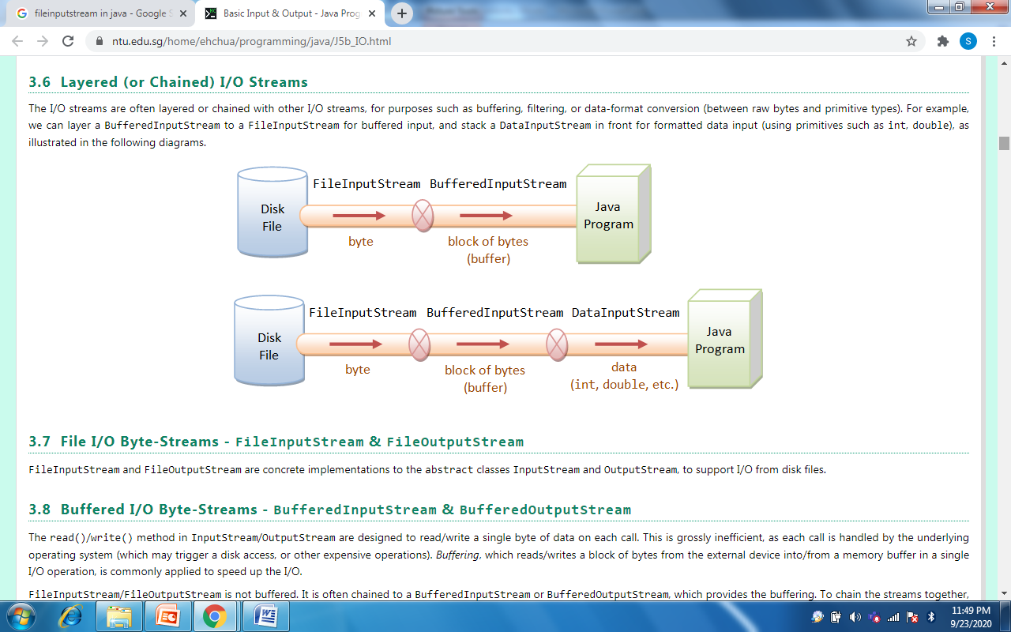

Slide 18

Example using DataInputStream class of Byte Stream Classes
Java DataInputStream class allows an application to read primitive data from the input stream in a machine-independent way. import java.io.*; class inout { public static void main(String args[])throws IOException { int roll; String name; DataInputStream d=new DataInputStream(System.in); System.out.println("Enter Roll No"); roll=Integer.parseInt(d.readLine()); System.out.println("Enter name"); name=d.readLine(); System.out.println("ROLL : "+roll); System.out.println("NAME : "+name); } //readLine() is a function in DataInputStream } //class and return type is String

Slide 19
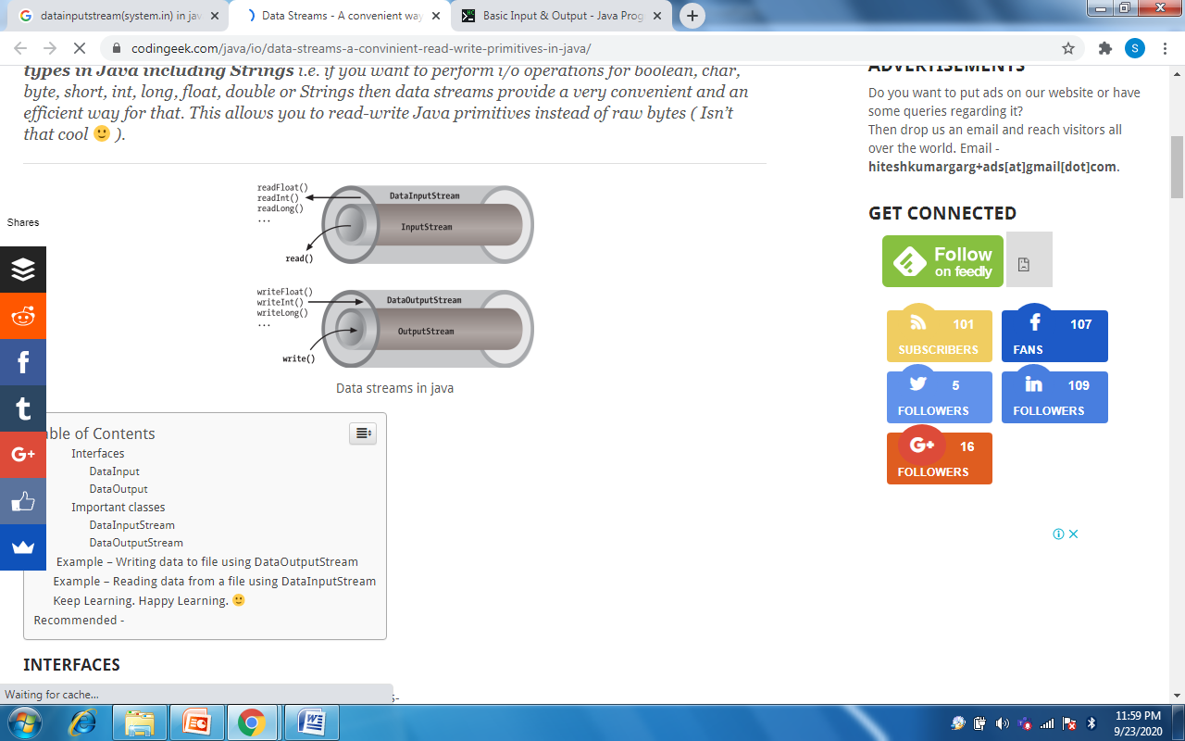

Slide 20
Example using ByteArrayInputStream class
The ByteArrayInputStream is composed of two words: ByteArray and InputStream. As the name suggests, it can be used to read byte array as input stream. Java ByteArrayInputStream class contains an internal buffer which is used to read byte array as stream. In this stream, the data is read from a byte array. /* This example demonstrates how to read one byte from the input stream at a time. */ import java.io.*; public class ReadByteStreams { public static void main(String args[])throws IOException { String str = args[0]; byte b[] = str.getBytes(); ByteArrayInputStream bais = new ByteArrayInputStream(b); int r; while ((r = bais.read()) != -1) { System.out.print((char) r + " "); } } }

Slide 21
Predefined Streams
java.lang package defines a class called System which is automatically imported.
System contains three predefined public and static stream variables: in, out, and err
    public static InputStream in − It is the "standard" input stream.
    public static PrintStream out − It is the "standard" output stream.
    public static PrintStream err − It is the "standard" error output stream.
  System.in refers to standard input stream, which is the keyboard by default. It enables the program to read data from keyboard.
  System.out refers to the standard output stream. By default, this is the console.
  System.err refers to the standard error stream, which also is the console by default.
System.in is an object of type InputStream.
System.out and System.err are objects of type PrintStream

Slide 22
Example
The code to print output and an error message to the console.
System.out.println("simple message"); System.err.println("error message");
The code to get input from console.
int i=System.in.read(); //returns ASCII code of 1st
character

Slide 23
Character Stream Classes
Two abstract classes for Character streams :
  Reader
  Writer
These abstract classes handle Unicode character streams.
These classes define several key methods that the other stream classes implement.
Eg: read() and write(), are methods which read and write characters of data, respectively. These methods are overridden by derived stream classes.

Slide 24
Character Stream Classes
Stream Class | Meaning
BufferedReader | Buffered input character stream
BufferedWriter | Buffered output character stream
CharArrayReader | Input stream that reads from a character array
CharArrayWriter | Output stream that writes to a character array
FileReader | Input stream that reads from a file
FileWriter | Output stream that writes to a file
FilterReader | Filtered reader
FilterWriter | Filtered writer
InputStreamReader | Input stream that translates bytes to characters
LineNumberReader | Input stream that counts lines
OutputStreamWriter | Output stream that translates characters to bytes
PipedReader | Input pipe refers to stream between threads for inter thread communication
PipedWriter | Output pipe refers to stream between threads for inter thread communication
PrintWriter | Output stream that contains print( ) and println( )
PushbackReader | Input stream that allows characters to be returned to the input stream
Reader | Abstract class that describes character stream input
StringReader | Input stream that reads from a string
StringWriter | Output stream that writes to a string
Writer | Abstract class that describes character stream output

Slide 25
Reading Console Inputs
In Java, there are three different ways for reading input from the user in the command line environment(console).
  Using Buffered Reader Class
  Using Scanner Class
  Using Console Class
1.Using Buffered Reader Class
The following line of code creates a BufferedReader that is connected to the keyboard:
BufferedReader br = new BufferedReader(new
InputStreamReader(System.in));
BufferedReader- buffers the input charater stream
Now br is a character-based stream that is linked to the console through System.in.
        InputStreamReader - converts bytes to char
System.in - console input byte stream

Slide 26
import java.io.*; class Test { public static void main(String args[]) throws IOException { //Enter data using BufferReader BufferedReader reader = new BufferedReader(new InputStreamReader(System.in)); // Reading data using readLine String name = reader.readLine(); // Printing the read line System.out.println(name); } }
This method is used by wrapping the System.in (standard input stream) in an InputStreamReader which is wrapped in a BufferedReader. We can read input from the user in the command line. • Advantage - The input is buffered for efficient reading • Drawback - The wrapping code is hard to remember.

Slide 27
2. Using Scanner Class
• This is probably the most preferred method to take input.
• The main purpose of the Scanner class is to parse primitive types and strings using regular expressions, however it is also can be used to read input from the user in the command line.
Advantages: • Convenient methods for parsing primitives (nextInt(), nextFloat(), …) from the tokenized input.
• Regular expressions can be used to find tokens.
Drawback:
• The reading methods are not synchronized

Slide 28
The Scanner class is used is found in the java.util package.
Example
import java.util.Scanner;
class GetInputFromUser {
public static void main(String args[]) {
// Using Scanner for Getting Input from User
Scanner in = new Scanner(System.in);
String s = in.nextLine();
System.out.println("You entered string "+s);
int a = in.nextInt();
System.out.println("You entered integer "+a);
} }

Slide 29
3. Using Console Class
The Java Console class is be used to get input from console. It provides methods to read texts and passwords.
Advantages:
Reading password without echoing the entered characters.
Reading methods are synchronized.
Format string syntax can be used.
Drawback:
Does not work in non-interactive environment (such as in an IDE).

Slide 30
// Java program to demonstrate working of System.console() // Note that this program does not work on IDEs as //System.console() may require console.
Example
public class Sample {
public static void main(String[] args)
{
// Using Console to input data from user
String name = System.console().readLine();
System.out.println(name);
}
}

Slide 31
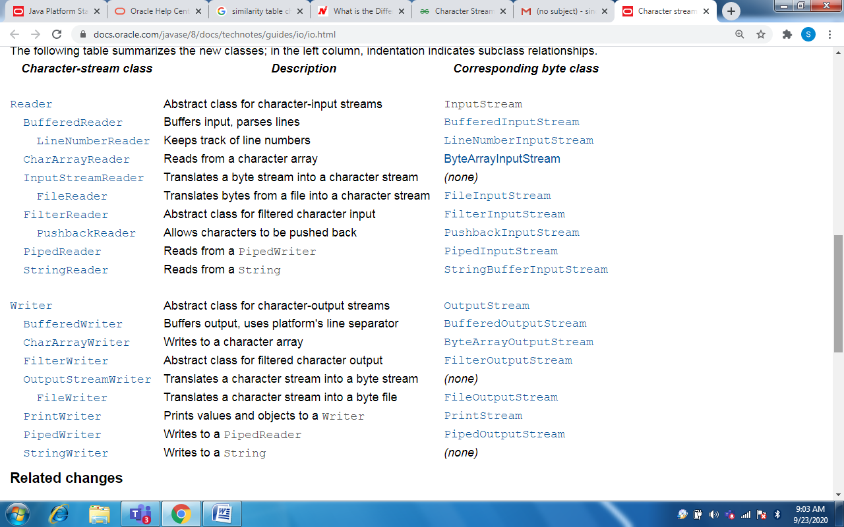
Comparing Byte Stream classes and Character Stream classes

Slide 32
Reading a Character
read( )
int read( ) throws IOException
Reads a character from the input stream and returns an integer value.
It returns –1 when the end of the stream is encountered.

Slide 33
import java.io.*; class BRRead { public static void main(String args[]) throws IOException { char c; BufferedReader br = new BufferedReader(new InputStreamReader(System.in)); System.out.println("Enter characters, 'q' to quit."); do { c = (char) br.read(); System.out.println(c); } while(c != 'q'); } }
Output: Enter characters, 'q' to quit. 123abcq 1 2 3 a b c q

Slide 34
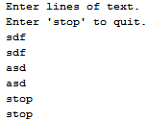
Reading a String
readLine( )
String readLine( ) throws IOException
import java.io.*; class BRReadLines { public static void main(String args[]) throws IOException { BufferedReader br = new BufferedReader(new InputStreamReader(System.in)); String str; System.out.println("Enter lines of text."); System.out.println("Enter 'stop' to quit."); do { str = br.readLine(); System.out.println(str); } while(!str.equals("stop")); } }

Slide 35
Q) Write a program to read 100 lines of text or until stop is entered and store it in an array. Display the array.

Slide 36
//A tiny Text Editor import java.io.*; class TinyEdit { public static void main(String args[]) throws IOException { BufferedReader br = new BufferedReader(new InputStreamReader(System.in)); String str[] = new String[100]; System.out.println("Enter lines of text."); System.out.println("Enter 'stop' to quit."); for(int i=0; i<100; i++) { str[i] = br.readLine(); if(str[i].equals("stop")) break; } System.out.println("\nHere is your array:"); for(int i=0; i<100; i++) { if(str[i].equals("stop")) break; System.out.println(str[i]); } } }

Slide 37
Writing Console Outputs
Console output is obtained with print() and println() methods defined by PrintStream class(which is the type of object referenced by System.out)
PrintStream also implements write( ).
write( ) can be used to write to the console.
void write(int byteval)
This method writes to the stream the byte specified by byteval.
byteval is declared as an integer, only the low-order eight bits are written.
class WriteDemo { public static void main(String args[]) { int b; b = 'A'; System.out.write(b); System.out.write('\n'); } }

Slide 38
PrintWriter Class
The recommended method of writing to the console is through a PrintWriter stream.
PrintWriter is the character-based classes.
PrintWriter(OutputStream outputStream, boolean flushOnNewline)
flushOnNewline controls whether Java flushes the output stream every time a println( ) method is called. If flushOnNewline is true, flushing automatically takes place. If false, flushing is not automatic.
PrintWriter pw = new PrintWriter(System.out, true);

Slide 39
import java.io.*; public class PrintWriterDemo { public static void main(String args[]) { PrintWriter pw = new PrintWriter(System.out, true); pw.println("This is a string"); int i = -7; pw.println(i); double d = 4.5e-7; pw.println(d); } }
Output: This is a string -7 4.5E-7

Slide 40
Reading and Writing a File
The stream classes used for file operations are
  FileInputStream and FileOutputStream
To open a file :
FileInputStream(String fileName) throws FileNotFoundException
FileOutputStream(String fileName) throws FileNotFoundException
fileName specifies the name of the file that we want to open.
If the file does not exist, then FileNotFoundException is thrown.
For output streams, if the file cannot be created, then FileNotFoundException is thrown.
When an output file is opened, any pre-existing file by the same name is destroyed.

Slide 41
File Methods
close() method is used to close a file.
It is defined by both FileInputStream and FileOutputStream
void close( ) throws IOException
read( ) : To read from a file, defined by FileInputStream
int read( ) throws IOException
It reads a single byte from the file and returns the byte as an integer value. read( ) returns –1 when the end of the file is encountered.
write( ) : To write to a file, defined by FileOutputStream.
void write(int byteval) throws IOException
Writes the byte specified by byteval to the file. If an error occurs during writing, an IOException is thrown.

Slide 42
Example :
Write a program that uses read( ) to input from a file specified as command line argument. Display the contents of the text file.

Slide 43
import java.io.*; class ShowFile { public static void main(String args[]) throws IOException { int i; FileInputStream fin; try { fin = new FileInputStream(args[0]); } catch(FileNotFoundException e) { System.out.println("File Not Found"); return; } catch(ArrayIndexOutOfBoundsException e) { System.out.println(“Enter an argument"); return; } do { i = fin.read(); if(i != -1) System.out.print((char) i); } while(i != -1); fin.close(); } }

Slide 44
Q1)Write a program to copy contents from one file to another file using command line arguments.

Slide 45
import java.io.*; class CopyFile { public static void main(String args[]) throws IOException { int i; FileInputStream fin; FileOutputStream fout; try { fin = new FileInputStream(args[0]); fout = new FileOutputStream(args[1]); } catch(FileNotFoundException e) { System.out.println("Input File Not Found"); return; } catch(ArrayIndexOutOfBoundsException e) { System.out.println("Usage: CopyFile From To"); return; } try { do { i = fin.read(); if(i != -1) fout.write(i); } while(i != -1); } catch(IOException e) { System.out.println("File Error"); } fin.close(); fout.close(); } }

Slide 46
Write a program to read product code and name from keyboard and write it to a file

Slide 47
TUTORIAL
Q1) Write a program to create a file that could store details of three students. Details include rollno, name and address and are provided through keyboard.
Q2) Write a Java program that accepts N integers through console and sort them in ascending order.
Q3) Write a java program that accepts integers from a file and display their sum.
Q4)Write a program to count the number of words in a text file.

